Slide 1
cfDNA as a diagnostic tool for early cancer detection
NIBR/GDD/ Genesis Labs
Students; Aamna Al-Shehhi, Calina Copos, Madhav Kothari, Rebaz Ahmed, Seth Hilliard
Investigators: Alejandro Balbin, Rebecca Leary, Markus Riester, Ben Gustafson, Katie Daco
Novartis – Academia Hackathon 2019
Cambridge, August 23rd, 2019

Slide 2
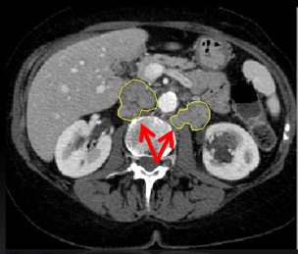
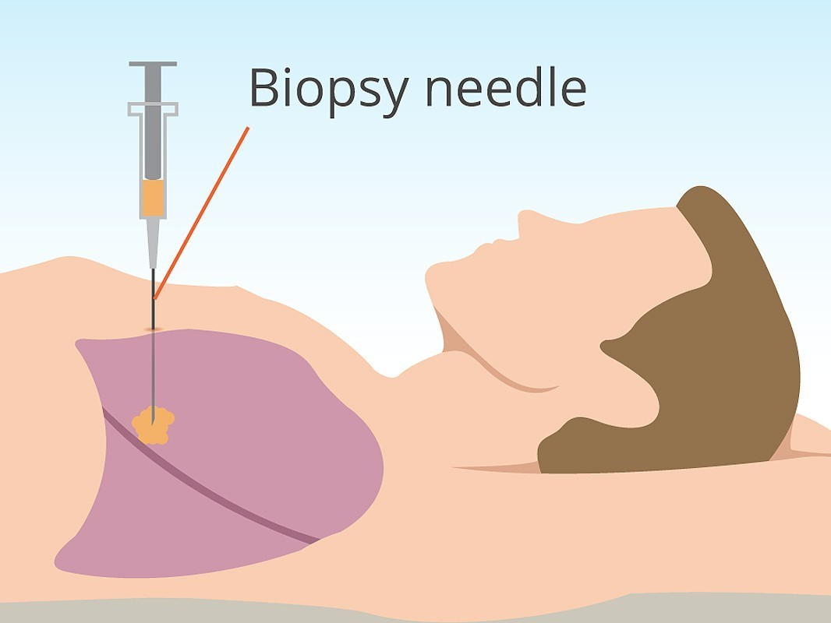
How do we detect cancer?
Can we utilize routine blood samples to detect cancer?

Slide 3

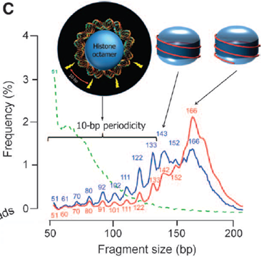
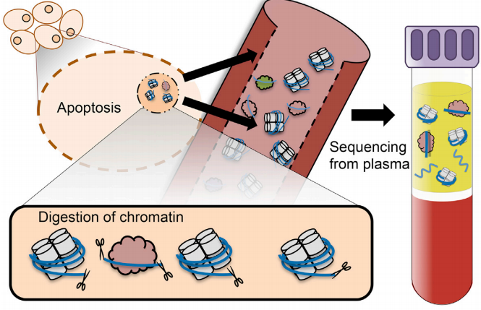
What can be detected in circulation?

Slide 4

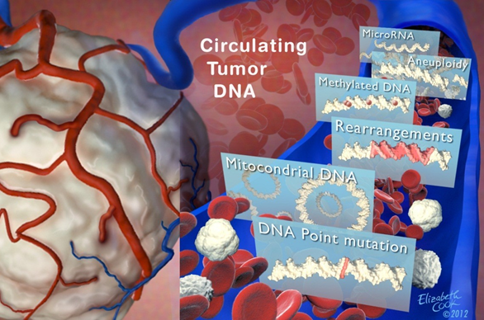
What can we measure about ctDNA?
Presence or absence of ctDNA
Quantification of ctDNA over time
Genotype of ctDNA
Changes of ctDNA genotype over time

Slide 5
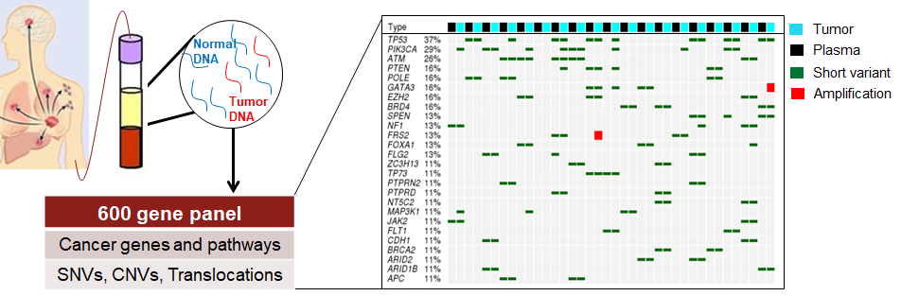
Where is Novartis looking today?
What can we learn beyond mutations?

Slide 6
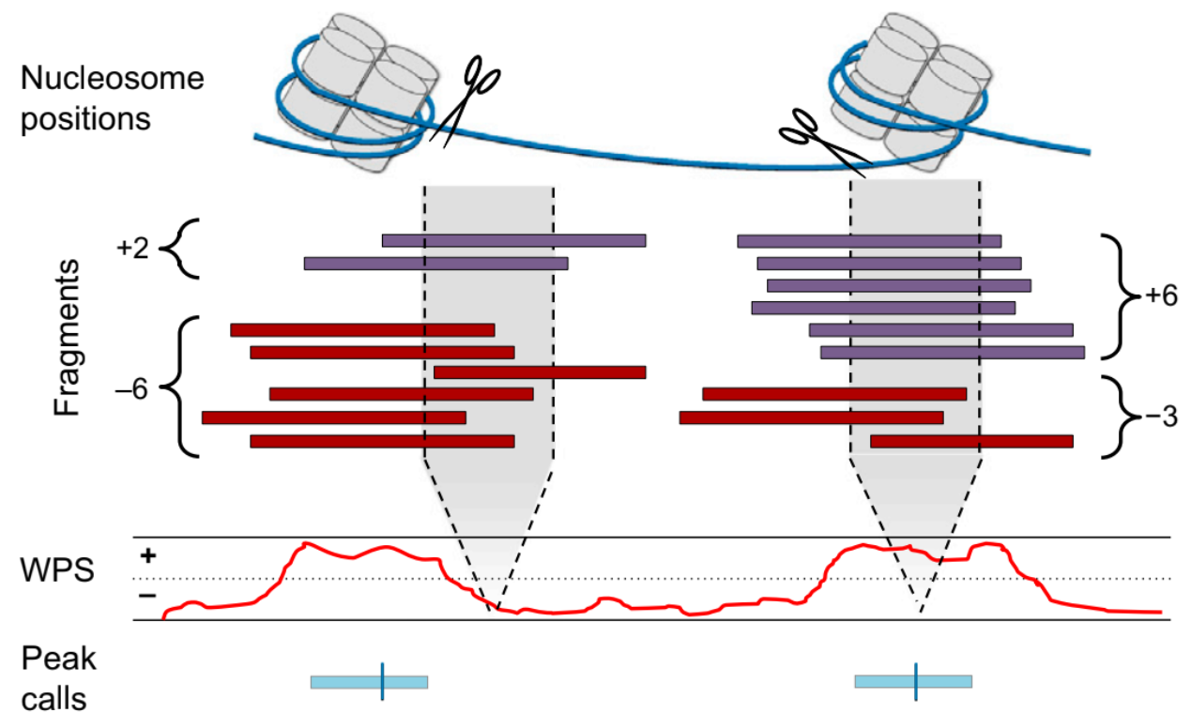
Once upon a time...
Window Protection Score (WPS)
What data is important?
What resolution is important?
How do we make this ML ready?

Slide 7
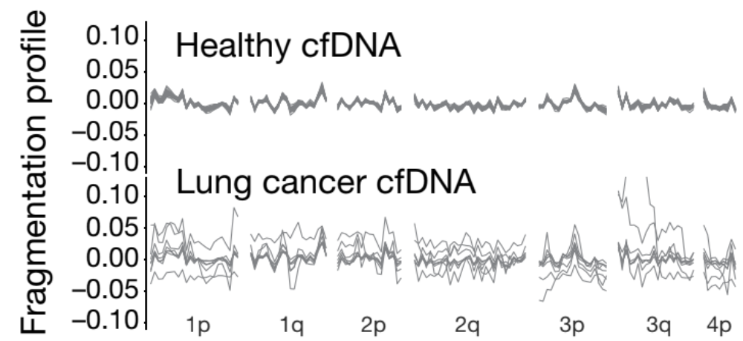
Thinking of WPS as a wave
Cristiano et al: Nature 2019
Now we can calculate features such as;
Mean, Variance, Amplitude, Power, Peak Frequency

Slide 8
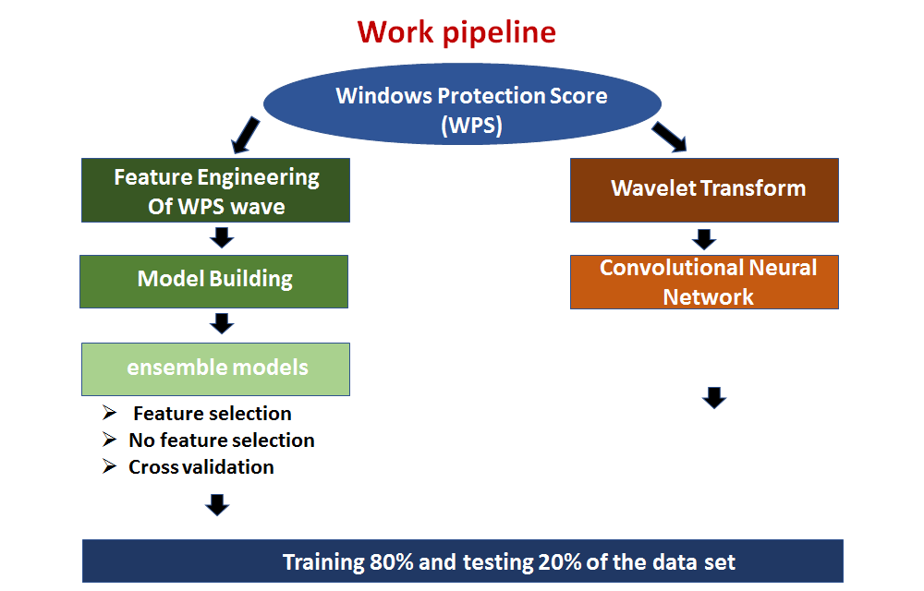
The journey

Slide 9
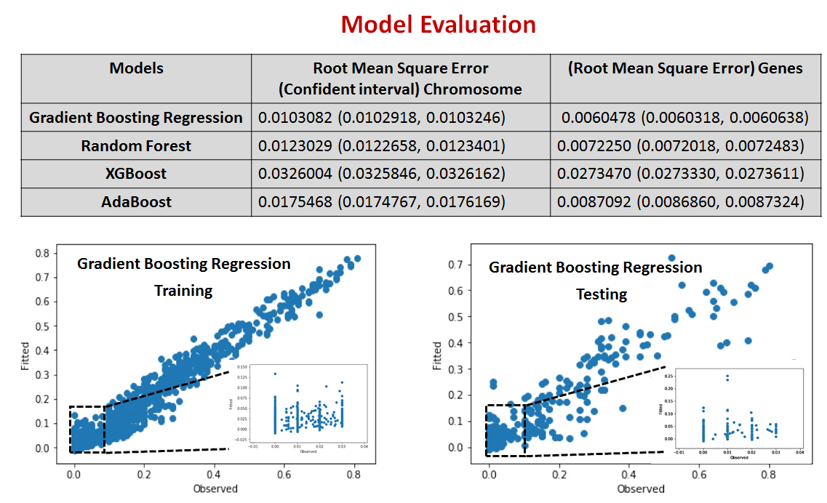
Example outputs

Slide 10
Most easily interpreted results
Model | Concordant | Acceptable | Unacceptable | Percent Performance
Chromosome Level Random Forest Training | 47 | 26 | 22 | 76.84210526
Chromosome Level Random Forest Testing | 4 | 11 | 6 | 71.42857143
Combined Gradient Boosting Regression Training | 57 | 23 | 15 | 84.21052632
Combined Gradient Boosting Regression Testing | 7 | 8 | 6 | 71.42857143
Combined Random Forest Training | 53 | 23 | 19 | 80
Combined Random Forest Testing | 9 | 6 | 6 | 71.42857143

Slide 11
Future directions
More features can be produced from WPS
Study other variables in conjunction with WPS
WPS might not sufficiently capture fragment information
We were unable to finish our Deep Learning

Slide 13
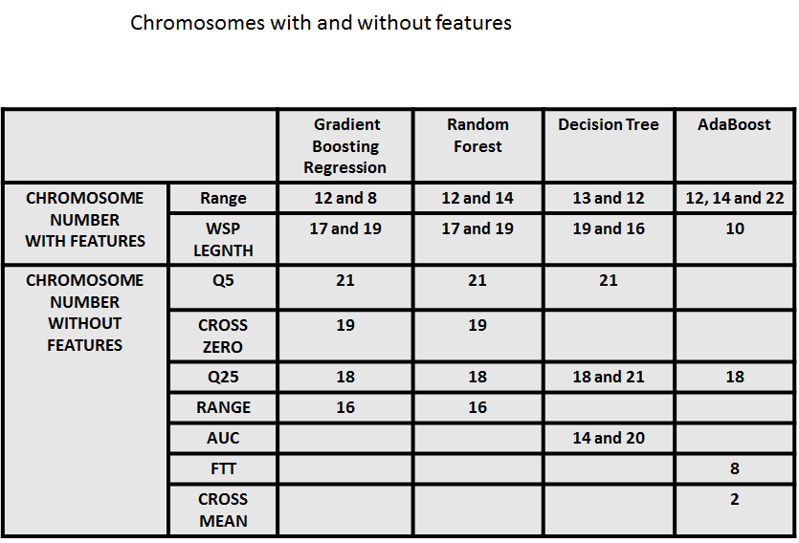
In case of questions, please break

Slide 14
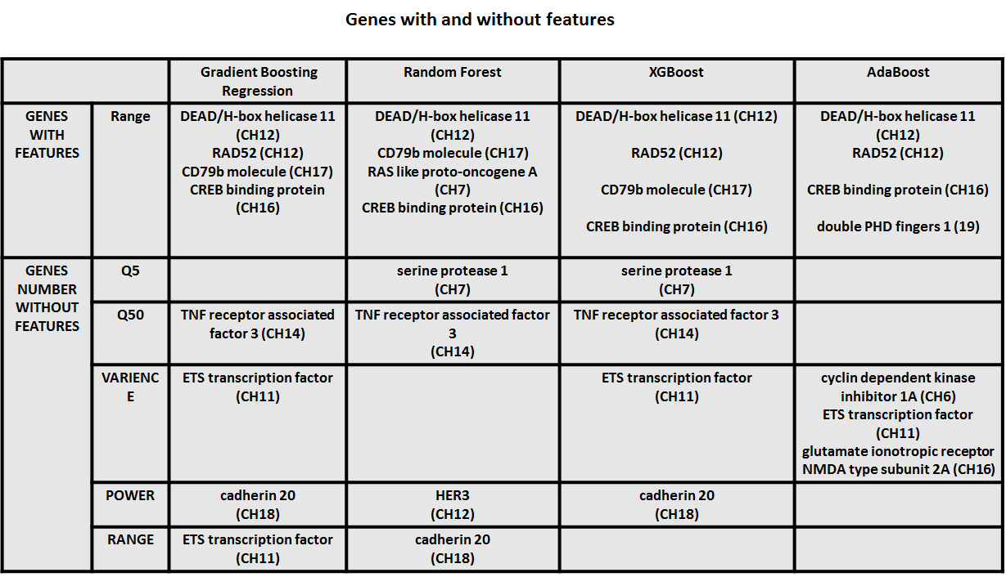

Slide 15
